Slide 1
SC-200T00A Microsoft Security Operations Analyst
Author name Date

Slide 2
Module 1: Mitigate threats using Microsoft Defender for Endpoint

Slide 3
Module agenda
Protect against threats with Microsoft Defender for Endpoint
Perform actions on a device using Microsoft Defender for Endpoint
Deploy the Microsoft Defender for Endpoint environment
Perform evidence and entities investigations using Microsoft Defender for Endpoint
Implement Windows 10 security enhancements with Microsoft Defender for Endpoint
Configure and manage automation using Microsoft Defender for Endpoint
Manage alerts and incidents in Microsoft Defender for Endpoint
Configure for alerts and detections in Microsoft Defender for Endpoint
Perform device investigations in Microsoft Defender for Endpoint
Utilize Threat and Vulnerability Management in Microsoft Defender for Endpoint

Slide 4
Lesson 1: Protect against threats with Microsoft Defender for Endpoint

Slide 5
Lesson introduction
After this lesson, you will be able to:
Define the capabilities of Microsoft Defender for Endpoint
Understand how to hunt threats within your network.
Explain how Microsoft Defender for Endpoint can remediate risks in your environment

Slide 6
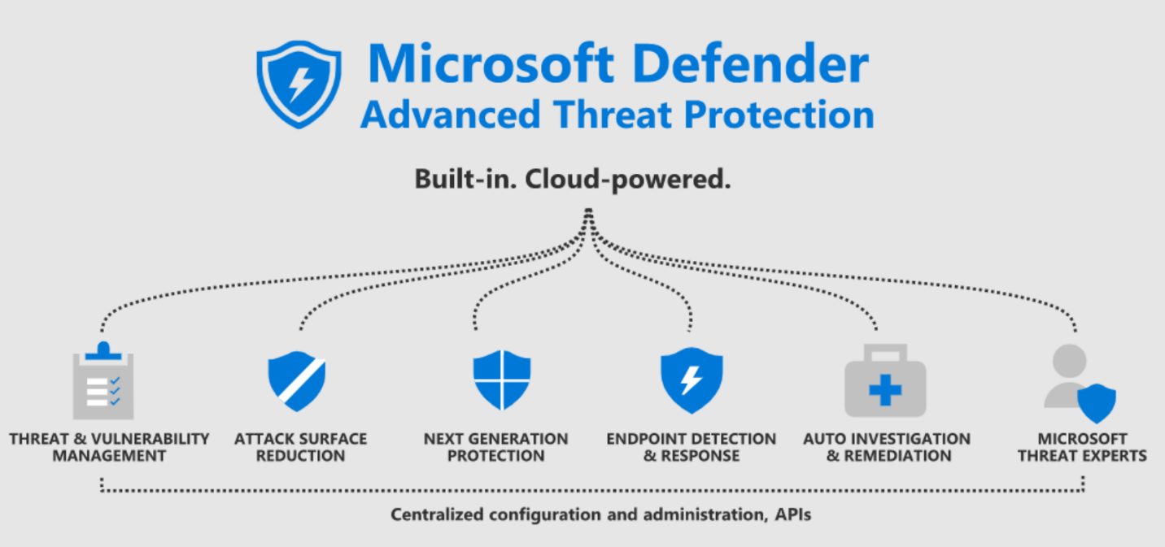
Microsoft Defender for Endpoint explained
Microsoft Defender for Endpoint is a platform designed to help enterprise networks prevent, detect, investigate, and respond to advanced threats on their endpoints.
Notes:
Supporting videos for instructor or student use:
Video: Microsoft Defender for Endpoint
https://www.microsoft.com/en-us/videoplayer/embed/RE4CQvW?postJsllMsg=true
(6 minutes)
Video: Architecture of Microsoft Defender
(4:15 minutes)
https://www.microsoft.com/en-us/videoplayer/embed/RE4D0Wz?postJsllMsg=true

Slide 7
Practice security administration
Threat and vulnerability management
Attack surface reduction
Next generation protection
Endpoint detection and response
Automated investigation and remediation
Microsoft Threat Experts
Notes:
Supporting videos for instructor or student use:
Video: Threat and Vulnerability Management explained
https://www.microsoft.com/en-us/videoplayer/embed/RE4CYw7?postJsllMsg=true
(4:05 minutes)
Video: Attack Surface Reduction explained
https://www.microsoft.com/en-us/videoplayer/embed/RE4COmV?postJsllMsg=true
(6:25 minutes)
Video: Automated investigations
https://www.microsoft.com/en-us/videoplayer/embed/RE4CQAA?postJsllMsg=true
(4:34 minutes)

Slide 8
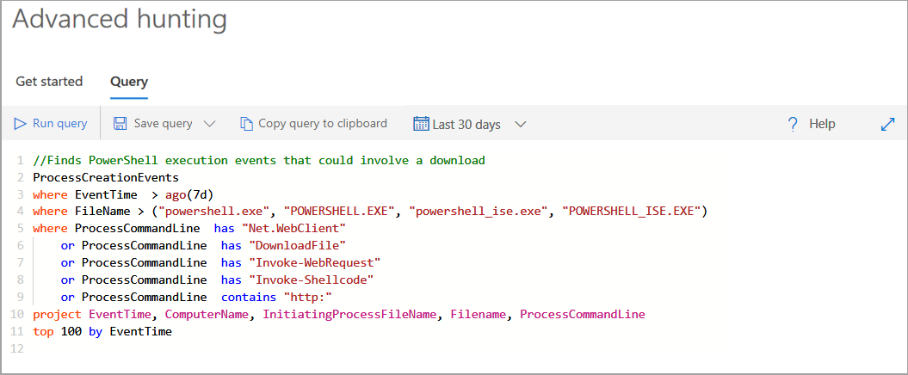
Hunt threats within your network
Advanced hunting within Microsoft Defender for Endpoint allows you to hunt for possible threats across your organization using a powerful search and query tool.
Notes:
Supporting videos for instructor or student use:
Video: Advanced Hunting Microsoft Defender
https://www.microsoft.com/en-us/videoplayer/embed/RE4COn3?postJsllMsg=true
(5 minutes)
Interactive Guide: Investigate and remediate threats with Microsoft Defender for Endpoint
https://aka.ms/MSDE-IG
(17 minutes)

Slide 9
Section break

Slide 10
Lesson 2: Deploy the Microsoft Defender for Endpoint environment

Slide 11
Lesson introduction
After this lesson, you will be able to:
Create a Microsoft Defender for Endpoint environment
Onboard devices to be monitored by Microsoft Defender for Endpoint
Configure Microsoft Defender for Endpoint environment settings

Slide 12
Create your environment
Microsoft 365 Defender portal https://security.microsoft.com
Data storage location:
Determine where you want to be hosted. You cannot change the location after this set up.
Data retention:
The default is six months.
Enable preview features:
The default is on, can be changed later.

Slide 13
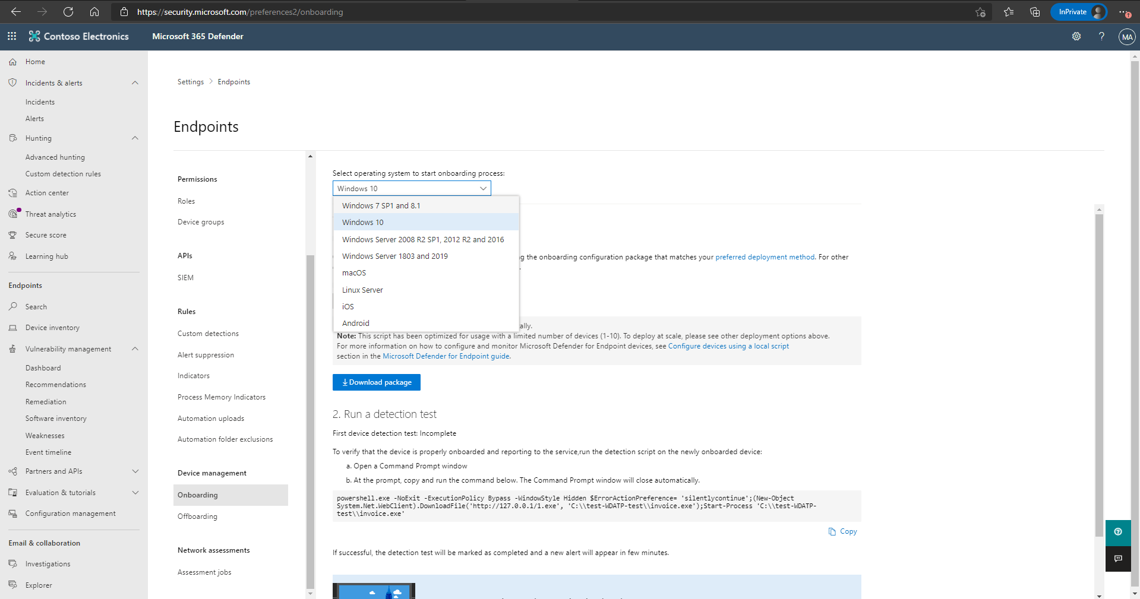
Onboard devices
You'll need to go to the onboarding section of the Defender for Endpoint portal to onboard any of the supported devices. Depending on the device, you'll be guided with appropriate steps and provided management and deployment tool options suitable for the device.
Notes:
Supporting videos for instructor or student use:
Microsoft Defender for Endpoint – Onboarding clients
https://www.microsoft.com/en-us/videoplayer/embed/RE4bGqr?rel=0&postJsllMsg=true
(3 minutes)

Slide 14
Manage access
Defender for Endpoint RBAC is designed to support your tier- or role-based model of choice and gives you granular control over what roles can see, devices they can access, and actions they can take.
Control who can take specific actions:
Create custom roles and control what Defender for Endpoint capabilities they can access with granularity.
Control who can see information on a specific device group or groups:
Create device groups by specific criteria such as names, tags, domains, and others, then grant role access to them using a specific Azure Active Directory (Azure AD) user group.
Notes:
Supporting videos for instructor or student use:
Role-based access control – Microsoft Defender ATP
https://www.microsoft.com/en-us/videoplayer/embed/RE4bJ2a?rel=0&postJsllMsg=true
(5 minutes)

Slide 15
Create and manage roles for role-based access control
Permission options
View data: Security operations
Alerts investigation
View data: Threat and vulnerability management (TVM)
Manage portal system settings
Active remediation actions: Security operations
Manage security settings in Security Center
Active remediation actions: TVM - Exception handling
Live response: Basic commands
Active remediation actions: TVM - Remediation handling
Live response: Advanced commands

Slide 16
Configure device groups
As part of the process of creating a device group, you'll:
create device groups and use them to:
Limit access to related alerts and data to specific Azure AD user groups with assigned RBAC roles
Set the automated remediation level for that group.
Configure different auto-remediation settings for different sets of devices
Specify the matching rule that determines which device group belongs to the group based on the device name, domain, tags, and OS platform.
Assign specific remediation levels to apply during automated investigations
Select the Azure AD user group that should have access to the device group.
In an investigation, filter the Devices list to just specific device groups by using the Group filter.
Rank the device group relative to other groups after it is created.

Slide 17
Section break

Slide 18
Lesson 3: Implement Windows 10 security enhancements

Slide 19
Lesson introduction
After this lesson, you will be able to:
Explain Attack Surface Reduction in Windows 10
Enable Attack Surface Reduction rules on Windows 10 devices
Configure Attack Surface Reduction rules on Windows 10 devices

Slide 20
Understand attack surface reduction
Attack surface reduction rules
Network protection
Hardware-based isolation
Web protection
Application control
Controlled folder access
Exploit protection
Network firewall
Notes:
Supporting videos for instructor or student use:
Attack surface reduction – Microsoft Defender ATP
https://www.microsoft.com/en-us/videoplayer/embed/RE4woug?postJsllMsg=true
(7 minutes)

Slide 21
Enable attack surface reduction rules
Sample ASR Rules:
Block executable content from email client and webmail
Block all Office applications from creating child processes
Block Office applications from creating executable content
Block Office applications from injecting code into other processes
Block execution of potentially obfuscated scripts
Use advanced protection against ransomware
Rule options:
Disable = 0
Block (enable ASR rule) = 1
Audit = 2
Deployment options:
Intune
MDM
Microsoft Endpoint Manager
Group Policy
Notes:
Instructor demonstration:
Endpoint Manager admin center
Endpoint security policies

Slide 22
Section break

Slide 23
Lesson 4: Manage alerts and incidents

Slide 24
Lesson introduction
After this lesson, you will be able to:
Investigate incidents in Microsoft Defender for Endpoint
Investigate alerts in Microsoft Defender for Endpoint
Perform advanced hunting in Microsoft Defender for Endpoint

Slide 25
Explain security operations in Microsoft Defender for Endpoint
Defender for Endpoint detection and response capabilities provide advanced attack detections that are near real-time and actionable.
When a threat is detected, alerts are created in the system for an analyst to investigate. Alerts with the same attack techniques or attributed to the same attacker are aggregated into an entity called an incident. Aggregating alerts in this manner makes it easy for analysts to investigate and respond to threats collectively.
Inspired by the "assume breach" mindset, Defender for Endpoint continuously collects behavioral cyber telemetry. This includes process information, network activities, deep optics into the kernel and memory manager, user sign in activities, registry and file system changes, and others.
Notes:
Supporting videos for instructor or student use:
Video: Incident Investigation
https://www.microsoft.com/en-us/videoplayer/embed/RE4qLUV?rel=0&postJsllMsg=true
(6 minutes)

Slide 26
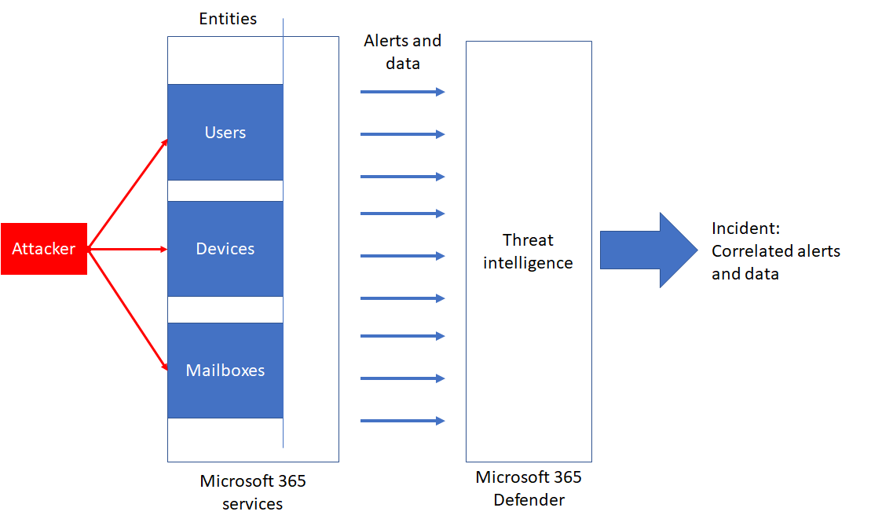
Manage and investigate incidents
An incident in Microsoft 365 Defender is a collection of correlated alerts and associated data that make up the story of an attack.
Notes:
Supporting videos for instructor or student use:
Microsoft Threat Protection – Incident management
https://www.microsoft.com/en-us/videoplayer/embed/RE4Bzwz?
(4 minutes)
You can use the Attack simulators to generate Incidents for demonstration purposes.

Slide 27
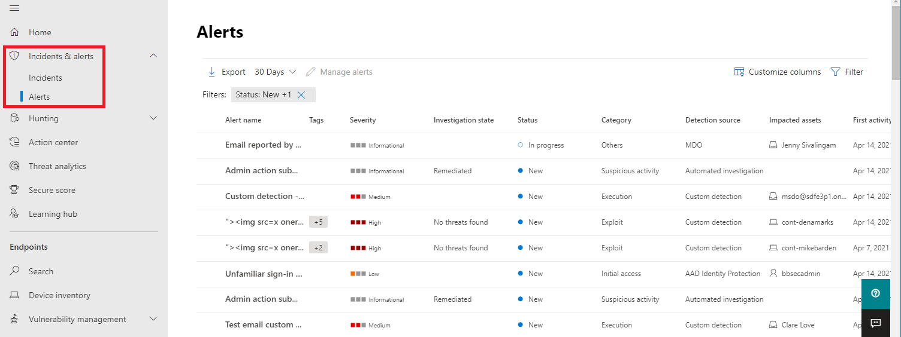
Manage and investigate alerts
You can update Incident management information, view all related information, or jump to investigation pages for the associated data.
Notes:
You can use the Attack simulators to generate Incidents for demonstration purposes
Supporting videos for instructor or student use:
Microsoft Defender for Endpoint: Using the new alert experience
https://www.microsoft.com/en-us/videoplayer/embed/RE4yiO5?rel=0&postJsllMsg=true
(3 minutes)

Slide 28
Manage automatic investigations
Microsoft Defender for Endpoint includes automated investigation and remediation (AIR) capabilities that can help your security operations team address threats more efficiently and effectively.
Notes:
You can use the Attack simulators to generate Incidents for demonstration purposes
Supporting videos for instructor or student use:
Microsoft Threat Protection: Automated self-healing
https://www.microsoft.com/en-us/videoplayer/embed/RE4BzwB
(4:37 minutes)

Slide 29
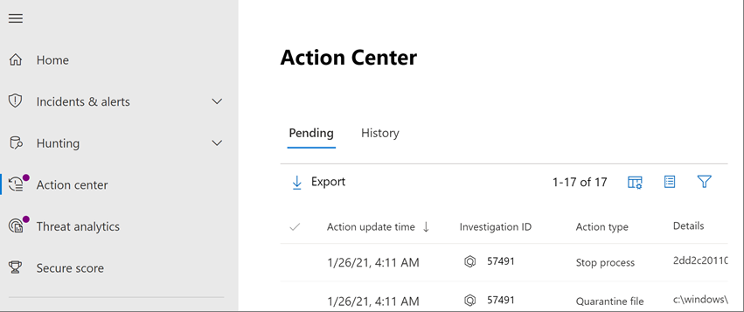
Use the Action Center
The action center consists of two main tabs: Pending actions and History.
Notes:
You can use the Attack simulators to generate Incidents for demonstration purposes

Slide 30
Perform advanced hunting
Advanced hunting is a query-based threat-hunting tool that lets you explore up to 30 days of raw data. You can proactively inspect events in your network to locate threat indicators and entities. The flexible access to data enables unconstrained hunting for both known and potential threats.
Perform root cause analysis
Create custom detections
Notes:
Supporting videos for instructor or student use:
Microsoft Defender for Endpoint: Advanced hunting
https://www.microsoft.com/en-us/videoplayer/embed/RE4bGqo?rel=0&postJsllMsg=true
(4:47 minutes)

Slide 31
Consult Microsoft threat experts
Microsoft Threat Experts is a managed threat hunting service that provides Security Operation Centers (SOCs) with expert level monitoring and analysis to ensure critical threats in their unique environments are not missed.
Targeted attack notification
Collaborate with experts, on demand
Notes:
Supporting videos for instructor or student use:
Microsoft Defender for Endpoint: Microsoft Threat Experts
https://www.microsoft.com/en-us/videoplayer/embed/RE4qZ0B?rel=0&postJsllMsg=true
(3:42 minutes)
Instructor demonstration:
Manage Incidents
Review an Alert
Review the Action Center

Slide 32
Section break

Slide 33
Lesson 5: Perform device investigations

Slide 34
Lesson introduction
After this lesson, you will be able to:
Use the device page in Microsoft Defender for Endpoint
Describe device forensics information collected by Microsoft Defender for Endpoint
Describe behavioral blocking by Microsoft Defender for Endpoint

Slide 35
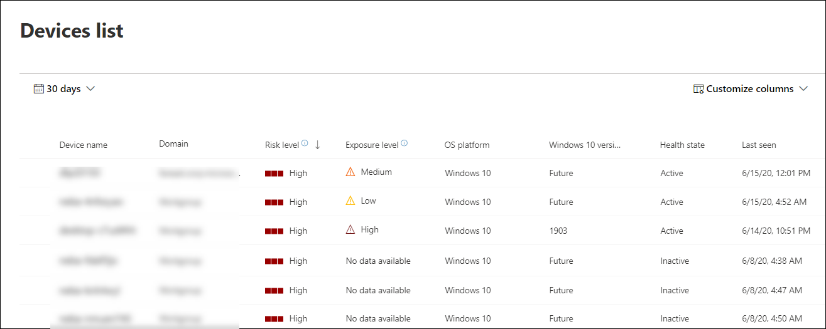
Use the device inventory list
The Device inventory page shows a list of the devices in your network where alerts were generated. By default, the queue displays devices with alerts seen in the last 30 days.

Slide 36
Investigate the device
When you investigate a specific device, you'll see: Device details, Response actions, Tabs for (overview, alerts, timeline, security recommendations, software inventory, discovered vulnerabilities, missing KBs), and Cards for (active alerts, logged on users, security assessment)

Slide 37
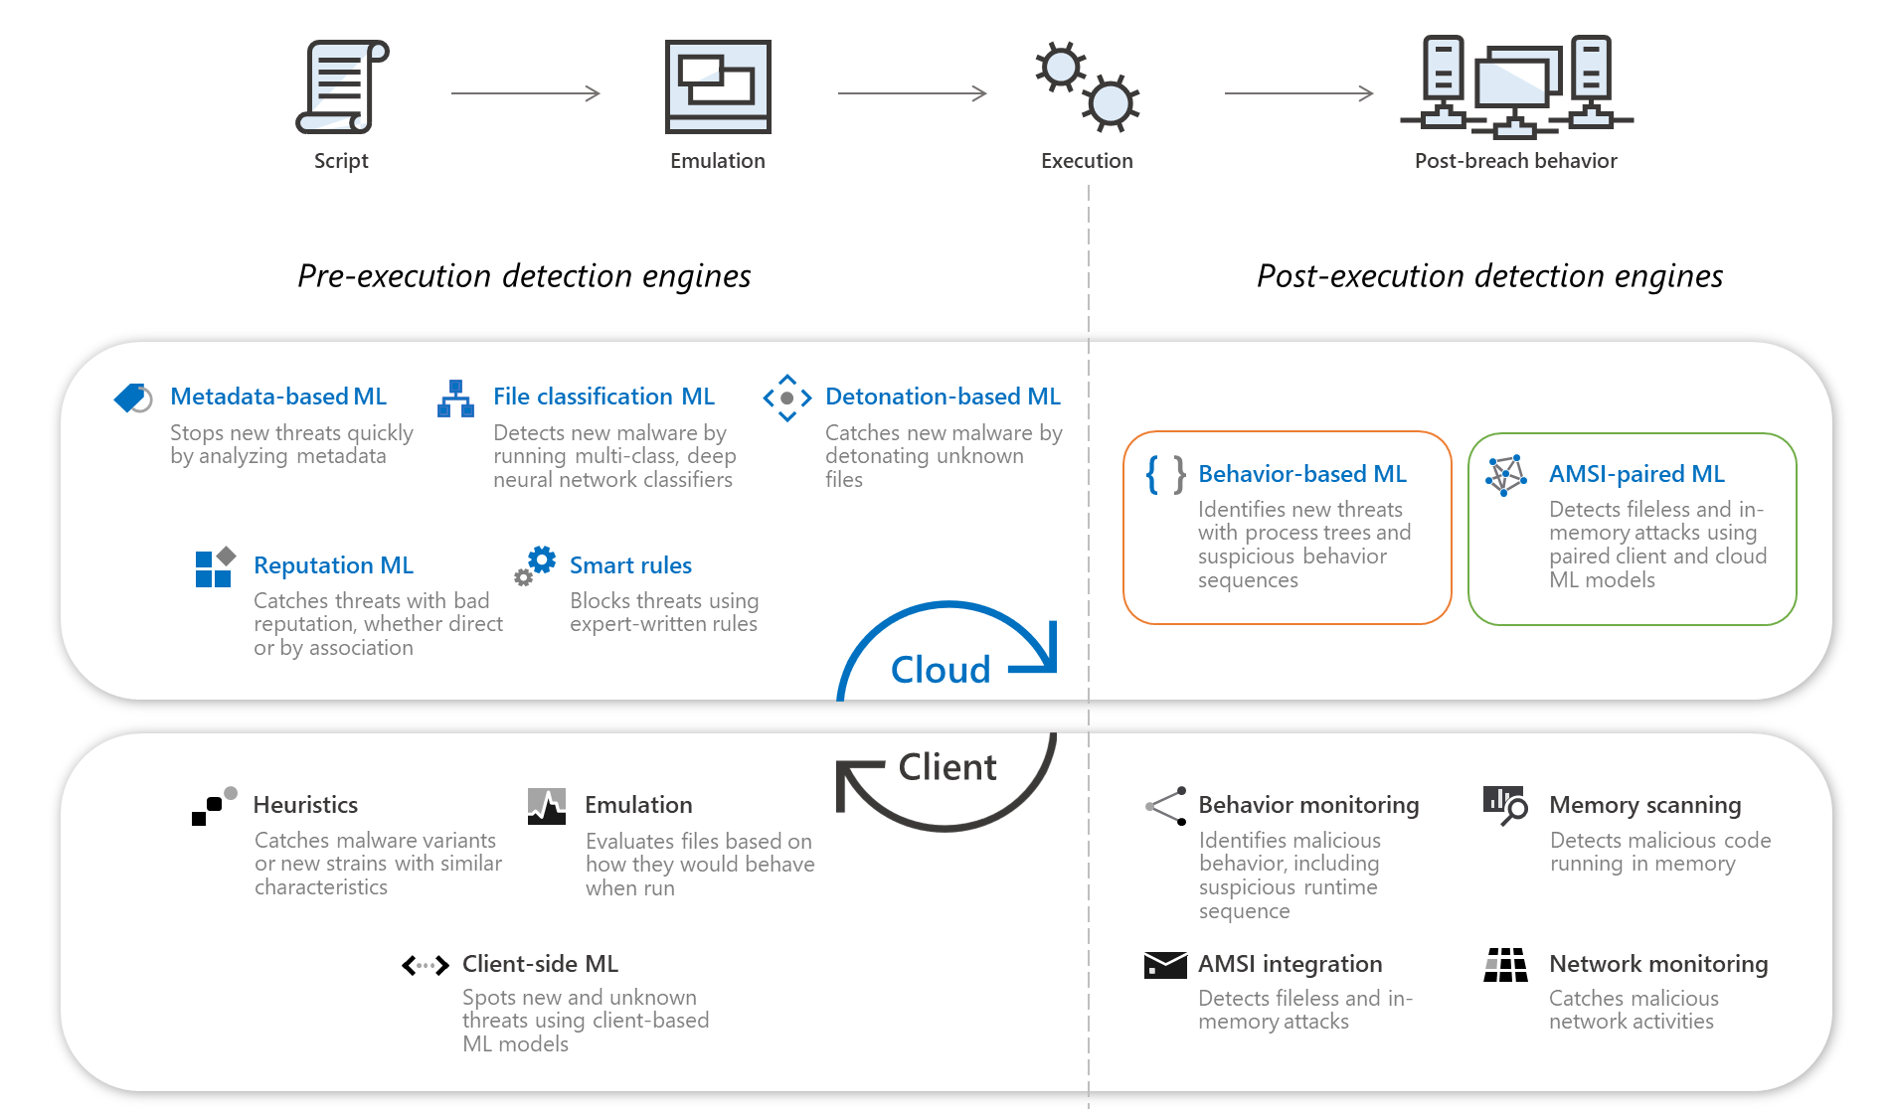
Use behavioral blocking
Notes:
Behavioral blocking and containment capabilities can help identify and stop threats based on their behaviors and process trees even when the threat has already started. Next-generation protection, EDR, and Defender for Endpoint components and features work together in behavioral blocking and containment capabilities.
Supporting videos for instructor or student use:
Microsoft Defender for Endpoint: EDR in block mode
https://www.microsoft.com/en-us/videoplayer/embed/RE4HjW2?rel=0&postJsllMsg=true
(3:42 minutes)
Instructor demonstration:
- Explore Device Page

Slide 38
Section break

Slide 39
Lesson 6: Perform actions on a device

Slide 40
Lesson introduction
After this lesson, you will be able to:
Perform actions on a device using Microsoft Defender for Endpoint
Conduct forensics data collection using Microsoft Defender for Endpoint
Access devices remotely using Microsoft Defender for Endpoint

Slide 41
Explain device actions
When investigating a device, you can perform actions, collect data, or remotely access the machine. Defender for Endpoint provides the device control required.
Containment actions:
Isolate Device
Restrict app execution
Run antivirus scan
Investigation actions:
Initiate Automated Investigation
Collect investigation package
Initiate Live Response Session

Slide 42
Collect investigation package from devices
As part of the investigation or response process, you can collect an investigation package from a device that contains:
Autoruns
Installed programs
Network connections
Prefetch files
Processes
Scheduled tasks
Security event log
Services
Windows Server Message Block (SMB) sessions
System information
Temp directories
Users and groups
WdSupportLogs

Slide 43
Initiate live response session
Live response gives security operations teams instantaneous access to a device (also referred to as a machine) using a remote shell connection.
Live response commands (examples)
Basic commands:
connections
fileinfo
persistence
processes
registry
scheduledtasks
services
Advanced commands:
analyze
getfile
run
library
putfile
remediate
Notes:
Supporting videos for instructor or student use:
Microsoft Defender for Endpoint: Live response
https://www.microsoft.com/en-us/videoplayer/embed/RE4qLUW?rel=0&postJsllMsg=true
(4 minutes)
Instructor demonstration:
Restrict App Execution
Collect and Investigation Package
Start an Automated Investigation
Perform Live Response

Slide 44
Section break

Slide 45
Lesson 7: Perform evidence and entities investigations

Slide 46
Lesson introduction
After this lesson, you will be able to:
Investigate files in Microsoft Defender for Endpoint
Investigate domains and IP addresses in Microsoft Defender for Endpoint
Investigate user accounts in Microsoft Defender for Endpoint

Slide 47
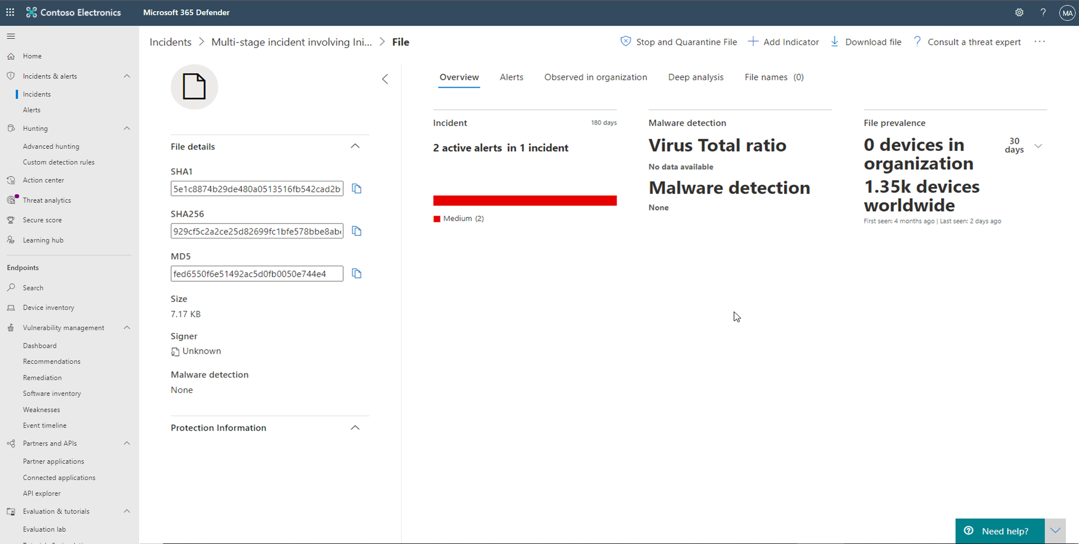
Investigate a file
Investigate the details of a file associated with a specific alert, behavior, or event to help determine if the file exhibits malicious activities, identify the attack motivation, and understand the potential scope of the breach.
Notes:
Supporting videos for instructor or student use:
Microsoft Defender for Endpoint: Deep analysis
https://www.microsoft.com/en-us/videoplayer/embed/RE4aAYy?rel=0&postJsllMsg=true
(3 minutes)

Slide 48
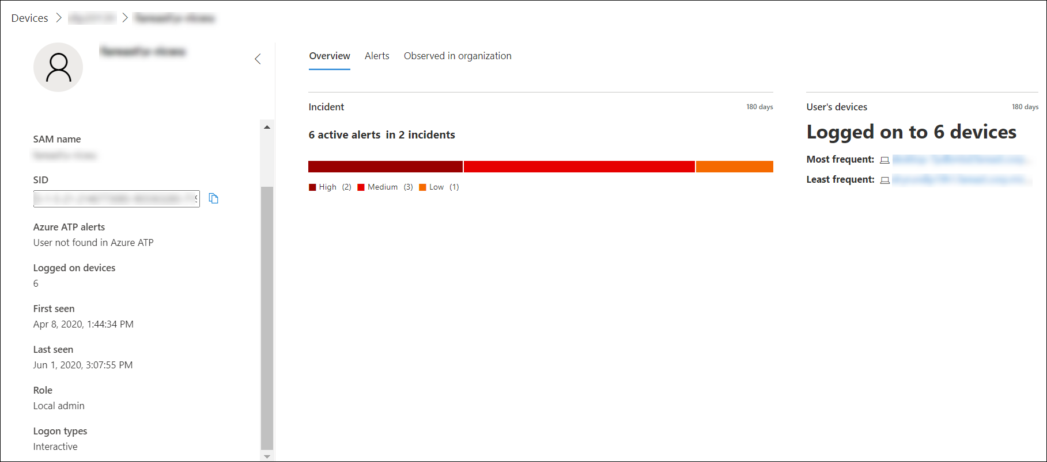
Investigate a user account
Identify user accounts with the most active alerts (displayed on the dashboard as "Users at risk") and investigate cases of potentially compromised credentials, or pivot on the associated user account when investigating an alert or device to identify possible lateral movement between devices with that user account.

Slide 49
Investigate an IP addresses
IP worldwide
Reverse DNS names
Alerts related to this IP
IP in organization
Prevalence

Slide 50
Investigate a domain
URL details, Contacts, Nameservers
Alerts related to this URL
URL in organization
Most recent observed devices with URL
Notes:
Instructor demonstration:
Explore File page
Explore Account page
Explore IP address page
Explore Domain page

Slide 51
Section break

Slide 52
Lesson 8: Configure and manage automation

Slide 53
Lesson introduction
After this lesson, you will be able to:
Configure advanced features of Microsoft Defender for Endpoint
Manage automation settings in Microsoft Defender for Endpoint

Slide 54
Configure advanced features
Automated Investigation
The Advanced features area provides many an on/off switch for features within the product. The following are settings that are automation focused.
Automatically resolve alerts
Enable EDR in block mode
Allow or block file

Slide 55
Manage automation upload and folder settings
File Content Analysis:
Enable the File Content Analysis capability so that certain files and email attachments can automatically be uploaded to the cloud for additional inspection in Automated investigation.
Memory Content Analysis:
Enable the Memory Content Analysis capability if you would like Microsoft Defender for Endpoint to automatically investigate memory content of processes. When enabled, memory content might be uploaded to Microsoft Defender for Endpoint during an Automated investigation.
Automation folder exclusions:
Automation folder exclusions allow you to specify folders that the Automated investigation will skip. You can control the following attributes about the folder that you'd like to be skipped:
Folders
Extensions of the files
File names

Slide 56
Configure automated investigation and remediation capabilities
1
Full - remediate threats automatically
2
Semi - require approval for any remediation
3
Semi - require approval for core folders remediation
4
Semi - require approval for non-temp folders remediation
5
No automated response

Slide 57
Block at risk devices
1
Turn on the Microsoft Intune connection from Microsoft 365 Defender portal
2
Turn on the Defender for Endpoint integration in Endpoint Manager
3
Create the compliance policy in Endpoint Manager
4
Assign the policy
5
Create an Azure AD Conditional Access policy
Notes:
Supporting videos for instructor or student use:
Microsoft Defender for Endpoint: Conditional access
https://www.microsoft.com/en-us/videoplayer/embed/RE4byD1?rel=0&postJsllMsg=true
(4 minutes)
Instructor demonstration:
Configure Device Group Remediation levels
Explore Automation settings

Slide 58
Section break

Slide 59
Lesson 9: Configure for alerts and detections

Slide 60
Lesson introduction
After this lesson, you will be able to:
Configure alert settings in Microsoft Defender for Endpoint
Manage indicators in Microsoft Defender for Endpoint

Slide 61
Configure advanced features
Live Response
The Advanced features area provides many an on/off switch for features within the product. The following are settings that are alert and detection focused.
Custom network indicators
Live Response unsigned script execution

Slide 62
Configure Email notifications
You can configure Defender for Endpoint to send email notifications to specified recipients for new alerts.
This feature enables you to identify a group of individuals who will immediately be informed and can act on alerts based on their severity.
Only users with 'Manage security settings' permissions can configure email notifications. If you've chosen to use basic permissions management, users with Security Administrator or Global Administrator roles can configure email notifications.
You can set the alert severity levels that trigger notifications. You can also add or remove recipients of the email notification. New recipients get notified about alerts encountered after they are added. For more information about alerts, see View and organize the Alerts queue.

Slide 63
Manage alert suppression
You can create suppression rules for specific alerts known to be innocuous, such as known tools or processes in your organization.

Slide 64
Manage indicators
Indicator of compromise (IoCs) matching is an essential feature in every endpoint protection solution. This capability gives SecOps the ability to set a list of detection indicators and for blocking (prevention and response).
File hashes
IP Addresses
URLs/Domains
Certificates
Notes:
Supporting videos for instructor or student use:
Microsoft Defender for Endpoint: Unified IoCs
https://www.microsoft.com/en-us/videoplayer/embed/RE4qLVw?rel=0&postJsllMsg=true
(4 minutes)

Slide 65
Manage custom detections
Custom detection rules built from advanced hunting queries let you proactively monitor various events and system states, including suspected breach activity and misconfigured devices.
Notes:
Instructor demonstrations:
Create alert notification rules
Create an Indicator

Slide 66
Section break

Slide 67
Lesson 10: Utilize Threat and Vulnerability Management

Slide 68
Lesson introduction
After this lesson, you will be able to:
Describe Threat and Vulnerability Management in Microsoft Defender for Endpoint
Identify vulnerabilities on your devices with Microsoft Defender for Endpoint
Track emerging threats in Microsoft Defender for Endpoint

Slide 69
Explain Threat and Vulnerability Management
Discover vulnerabilities and misconfigurations in real-time with sensors and without the need for agents or periodic scans. It prioritizes vulnerabilities based on the threat landscape, detections in your organization, sensitive information on vulnerable devices, and business context.
Bridging the workflow gaps
Real-time discovery
Intelligence-driven prioritization
Seamless remediation
Notes:
Supporting videos for instructor or student use:
Video: Threat and vulnerability management: discovery & remediation
https://www.microsoft.com/videoplayer/embed/RE4qLVs?rel=0
Interactive Guide: Threat and Vulnerability Management
https://aka.ms/MSDE_TVM_IG
(17 minutes)

Slide 70
Explore vulnerabilities on your devices
Software inventory
The Software inventory page opens with a list of software installed in your network.
Weaknesses
The Weaknesses page lists the software vulnerabilities your devices are exposed to by listing the Common Vulnerabilities and Exposures (CVE) ID.
Event timeline
The Event timeline is a risk news feed that helps you interpret how risk is introduced into the organization through new vulnerabilities or exploits.
Vulnerable devices report
The report shows graphs and bar charts with vulnerable device trends and current statistics.

Slide 71
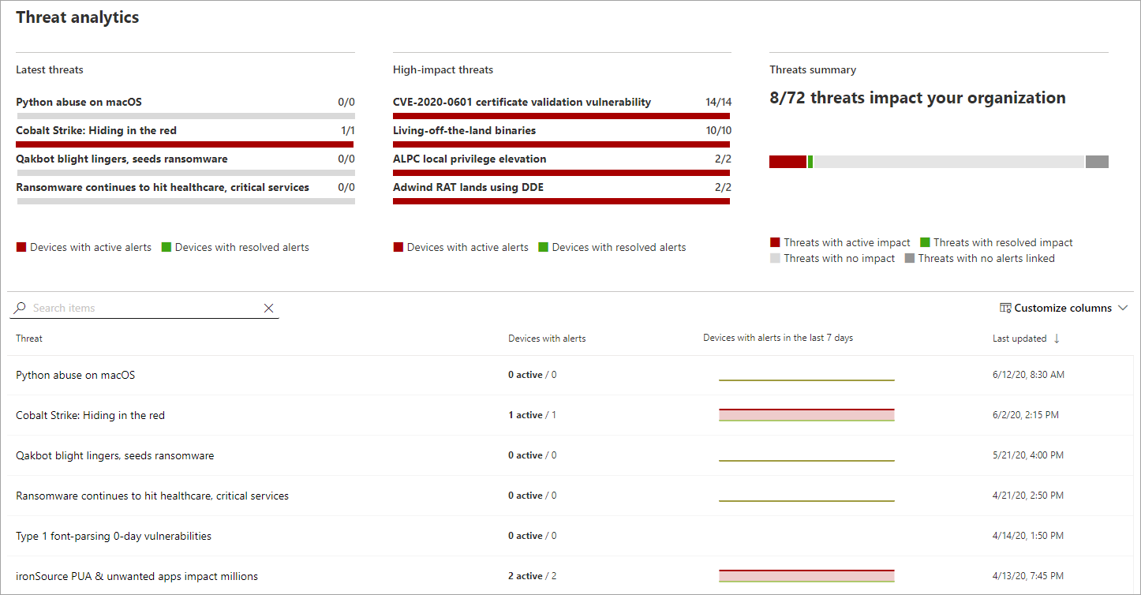
Track emerging threats with threat analytics
Assess the impact of new threats and review your resilience against or exposure to the threats.
Notes:
Instructor demonstration:
Explore TVM
Explore Threat analytics

Slide 72
Section break

Slide 73
Knowledge check
Check your knowledge with the module quiz in your course viewer

Slide 74
Lab 01 – Mitigate threats using Microsoft Defender for Endpoint

Slide 75
Lab Exercises
1
Deploy Microsoft Defender for Endpoint
2
Mitigate Attacks using Defender for Endpoint

Slide 76
Closing slide

